Slide 1
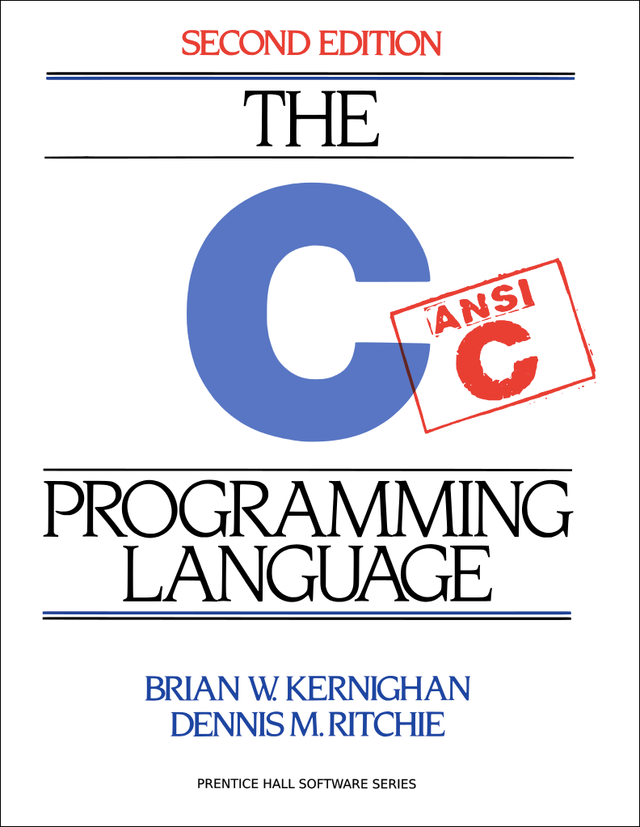
C Boot Camp
29 Sep 2014
Arjun Hans

Slide 2
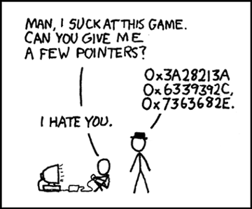
Agenda
C Basics
C Libraries
Debugging Tools
Version Control
Compilation
Demo

Slide 3
C Basics

Slide 4
C Basics
The minimum you must know to do well in this class
You have seen these concepts before
Make sure you remember them.
Summary:
Pointers/Arrays/Structs/Casting
Memory Management
Function pointers/Generic Types
Strings
GrabBag (Macros, typedefs, header guards/files, etc)

Slide 5
Pointers
Stores address of a value in memory
eg int*, char*, int**, etc
Access the value by dereferencing (*a); can be used to read value or write value to given address
Can’t dereference NULL
Pointer to type a references a block of sizeof(a) bytes
Get the address of a value in memory with the ‘&’ operator
Can alias pointers to same address
Demo Time!

Slide 6
Call by Value vs Call by Reference
Call-by-value: Changes made to arguments passed to a function aren’t reflected in the calling function
Call-by-reference: Changes made to arguments passed to a function are reflected in the calling function
C is a call-by-value language
To reflect changes to arguments outside the function, use pointers
Do not assign the pointer to a different value (that won’t be reflected!)
Instead, dereference the pointer and assign a value to that address
void swap(int* a, int* b) {
int temp = *a;
*a = *b;
*b = temp;
}
int x = 42;
int y = 54;
swap(&x, &y);
printf(“%d\n”, x); // 54
printf(“%d\n”, y); // 42

Slide 7
Pointer Arithmetic
Can add/subtract from an address to get a new address
Only perform when absolutely necessary (ie malloc)
Result depends on the pointer type
A+i, where A is a pointer = 0x100, i is an int (x86-64)
int* A: A+i = 0x100 + sizeof(int) * i = 0x100 + 4 * i
char* A: A+i = 0x100 + sizeof(char) * i = 0x100 + i
int** A: A + i = 0x100 + sizeof(int*) * i = 0x100 + 8 * i
Rule of thumb: cast pointer explicitly to avoid confusion
Prefer (char*)(A) + i vs A + i, even if char* A
Absolutely do this in macros (ie malloc)
Demo Time!

Slide 8
Structs
Group of variables placed under one name in a block of memory
Can embed structs, arrays in other structs
Given a struct instance, access the fields using the ‘.’ operator
Given a struct pointer, access the fields using the ‘->’ operator
struct foo_s {
int a;
char b;
};
struct bar_s {
char ar[10];
foo_s baz;
};
bar_s biz; // bar_s instance
biz.ar[0] = ‘a’;
biz.baz.a = 42;
bar_s* boz = &biz; // bar_s ptr
boz->baz.b = ‘b’;

Slide 9
Arrays/Strings
Arrays: fixed-size collection of elements of the same type
Can allocate on the stack or on the heap
int A[10]; // A is array of 10 int’s on the stack
int* A = calloc(10, sizeof(int)); // A is array of 10 int’s on the heap
Strings: Null-character (‘\0’) terminated character arrays
Null-character tells us where the string ends
All standard C library functions on strings assume null-termination.
Puzzle Time!

Slide 10
Casting
Can cast a variable to a different type
Changes the interpretation of the element
Integer Type Casting:
signed <-> unsigned: change interpretation of most significant bit
smaller signed -> larger signed: sign-extend (duplicate the sign bit)
smaller unsigned -> larger unsigned: zero-extend (duplicate 0)
Cautions:
cast explicitly, out of practice
never cast to a smaller type; will truncate (lose) data
never cast a pointer to a larger type and dereference it
Puzzle Time!

Slide 11
Malloc, Free, Calloc
Handle dynamic memory
void* malloc (size_t size):
allocate block of memory of size bytes
does not initialize memory to zero values
void* calloc (size_t num, size_t size):
allocate block of memory for array of num elements, each size bytes long
initializes memory to zero values
void free(void* ptr):
frees memory block, previously allocated by malloc, calloc, realloc, pointed by ptr
size argument:
should be computed using the sizeof operator
sizeof: can be applied to a type or an actual variable (please don’t do the later)
eg sizeof(int), sizeof(int*)

Slide 12
Memory Management Rules
Malloc what you free, free what you malloc
client should free memory allocated by client code
library should free memory allocated by library code
Number mallocs = Number frees
Number mallocs > Number Frees: definitely a memory leak
Number mallocs < Number Frees: definitely a double free
Free a malloc’d block only once
Should not dereference a free’d memory block
Puzzle Time!

Slide 13
Stack Vs Heap Allocation
Temporary variables (scope bound) are placed on the stack
deallocated after the variable leaves scope
do not return a pointer to a stack-allocated variable!
do not reference the address of a variable outside its scope!
Memory blocks allocated by calls to malloc/calloc are placed on the heap
Globals, constants are placed elsewhere
Example:
// a is a pointer on the stack to a memory block on the heap
int* a = malloc(sizeof(int));

Slide 14
Typedefs
Creates an alias type name for a different type
Useful to simplify names of complex data types
struct list_node {
int x;
};
typedef int pixel;
typedef struct list_node* node;
typedef int (*cmp)(int e1, int e2);
pixel x; // int type
node foo; // struct list_node* type
cmp int_cmp; // int (*cmp)(int e1, int e2) type

Slide 15
Macros
Fragment of code given a name; replace occurrence of name with contents of macro
No function call overhead, type neutral
Uses:
defining constants (INT_MAX, ARRAY_SIZE)
defining simple operations (MAX(a, b))
contracts! (REQUIRES, ENSURES)
Warnings:
Use parentheses around arguments/expressions, to avoid problems after substitution
Do not pass expressions with side effects as arguments to macros
#define INT_MAX 0x7FFFFFFFF
#define MAX(A, B) ((A) > (B) ? (A) : (B))
#define REQUIRES(COND) assert(COND)
#define WORD_SIZE 4
#define NEXT_WORD(a) ((char*)(a) + WORD_SIZE)

Slide 16
Function Pointers
Stores the address of a function.
Invoke the function by dereferencing the pointer, passing arguments to the function obtained
Syntax: <return_type> (*<fn_name>)(args)
int (*cmp)(int e1, int e2) = &compare_ints;
int val = (*cmp)(42, 54);
Uses:
memory management (client defines type used in implementation, must declare a method to free it!)
generic data structures and algorithms (eg comparators for different element types)
Puzzle Time!

Slide 17
Generic Types
void* type is C’s provision for generic types
Raw pointer to some memory location (unknown type)
Can’t dereference a void* (what is type void?)
Must cast void* to another type in order to dereference it
Can cast back and forth between void* and other pointer types
// stack usage:
int x = 42; int y = 54;
stack S = stack_new():
push(S, &x);
push(S, &y);
int a = *(int*)pop(S);
int b = *(int*)pop(S);
// stack implementation:
typedef void* elem;
stack stack_new();
void push(stack S, elem e);
elem pop(stack S);

Slide 18
Header Files
Includes C declarations and macro definitions to be shared across multiple files
Only include function prototypes/macros; no implementation code!
Usage: #include <header.h>
#include <lib> for standard libraries (eg #include <string.h>)
#include “file” for your source files (eg #include “header.h”)
Never include .c files (bad practice)
// list.h
struct list_node {
int data;
struct list_node* next;
};
typedef struct list_node* node;
node new_list();
void add_node(int e, node l);
// list.c
#include “list.h”
node new_list() {
// implementation
}
void add_node(int e, node l) {
// implementation
}
// stacks.h
#include “list.h”
struct stack_head {
node top;
node bottom;
};
typedef struct stack_head* stack
stack new_stack();
void push(int e, stack S);

Slide 19
Header Guards
Double-inclusion problem: include same header file twice
//grandfather.h
//father.h
#include “grandfather.h”
//child.h
#include “father.h”
#include “grandfather.h”
Error: child.h includes grandfather.h twice
Solution: header guard ensures single inclusion
//grandfather.h
#ifndef GRANDFATHER_H
#define GRANDFATHER_H
#endif
//father.h
#ifndef FATHER_H
#define FATHER_H
#endif
//child.h
#include “father.h”
#include “grandfather.h”
Okay: child.h only includes grandfather.h once

Slide 20
Odds and Ends
Prefix vs Postfix increment/decrement
a++: use a in the expression, then increment a
++a: increment a, then use a in the expression
Switch Statements:
remember break statements after every case, unless you want fall through (may be desirable in some cases)
should probably use a default case
Inline functions:
Variable/function modifiers:
global variables: defined outside functions, seen by all files
static variables/functions: seen only in file it’s declared in
extern: storage for variable is defined elsewhere

Slide 21
C Libraries

Slide 22
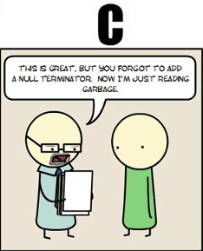
string.h: Common String/Array Methods
Possibly the most useful library available to you
Used heavily in shell/proxy labs
Important usage details regarding arguments:
prefixes: str -> strings, mem -> arbitrary memory blocks.
ensure that all strings are ‘/0’ terminated!
ensure that dest is large enough to store src!
ensure that src actually contains n bytes!
ensure that src/dest don’t overlap!

Slide 23
string.h: Common String/Array Methods
Copying:
void* memcpy (void* dest, void* src, size_t n): copy n bytes of src into dest, return dest
char* strcpy(char* dest, char* src): copy src string into dest, return dest
Concatenation:
char * strcat (char * dest, char* src): append copy of src to end of dest, return dest
Comparison:
int strcmp (char * str1, char * str2): compare str1, str2 by character (based on ASCII value of each character, then string length), return comparison result str1 < str2: -1, str1 == str2: 0, str1 > str2: 1

Slide 24
string.h: Common String/Array Methods (Continued)
Searching:
char* strstr (char * str1, char * str2): return pointer to first occurrence of str2 in str1, else NULL
char* strtok (char * str, char * delimiters): tokenize str according to delimiter characters provided in delimiters, return the next token per successive stroke call, using str = NULL
Other:
size_t strlen ( const char * str ): returns length of the string (up to, but not including the ‘\0’ character)
void * memset (void* ptr, int val, size_t n ): set first n bytes of memory block addressed by ptr to val (use this for setting bytes only; don’t use to set int arrays or anything else!)

Slide 25
stdlib.h: General Purpose Functions
Dynamic memory allocation:
malloc, calloc, free
String conversion:
int atoi(char* str): parse string into integral value (return 0 if not parsed)
System Calls:
void exit(int status): terminate calling process, return status to parent process
void abort(): aborts process abnormally
Searching/Sorting:
provide array, array size, element size, comparator (function pointer)
bsearch: returns pointer to matching element in the array
qsort: sorts the array destructively
Integer arithmetic:
int abs(int n): returns absolute value of n
Types:
size_t: unsigned integral type (store size of any object)

Slide 26
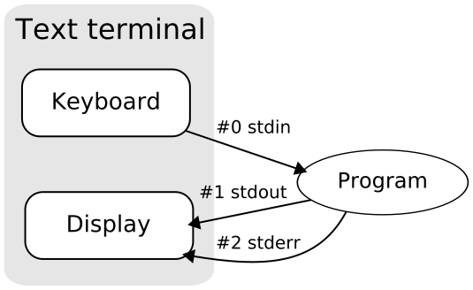
stdio.h
Another really useful library.
Used heavily in cache/shell/proxy labs
Used for:
argument parsing
file handling
input/output

Slide 27
stdio.h: Common I/O Methods
FILE* fopen (char* filename, char* mode): open the file with specified filename in specified mode (read, write, append, etc), associate it with stream identified by returned file pointer
int fscanf (FILE* stream, char* format, ...): read data from the stream, store it according to the parameter format at the memory locations pointed at by additional arguments.
int fclose (FILE* stream): close the file associated with the stream
int fprintf (FILE* stream, char* format, ... ): write the C string pointed at by format to the stream, using any additional arguments to fill in format specifiers.

Slide 28
Getopt
Need to include getopt.h and unistd.h to use
Used to parse command-line arguments.
Typically called in a loop to retrieve arguments
Switch statement used to handle options
colon indicates required argument
optarg is set to value of option argument
Returns -1 when no more arguments present
May be useful for Cache lab!
int main(int argc, char** argv){
int opt, x;
/* looping over arguments */
while(-1 != (opt = getopt(argc, argv, “x:"))){
switch(opt) {
case 'x':
x = atoi(optarg);
break;
default:
printf(“wrong argument\n");
break;
}
}
}

Slide 29
Note about Library Functions
These functions can return error codes
malloc could fail
a file couldn’t be opened
a string may be incorrectly parsed
Remember to check for the error cases and handle the errors accordingly
may have to terminate the program (eg malloc fails)
may be able to recover (user entered bad input)

Slide 30
Version Control

Slide 31
Version Control
You should use it. Now.
Avoid suffering during large labs (malloc, proxy)
Basic ideas:
complete record of everything that happened in your code repository
ability to create branches to test new components of code
ease in sharing code with other.
A skill that will pay you dividends in the future

Slide 32
Version Control Basics (Git)
git init:
Create a new repository
Indicated by .git file
git status:
Show working tree-status
Untracked files, modified files, deleted files, staged files
git add <file_name>
Stage a file to be committed (does not perform the commit)
git add . stages all files in current directory
git commit
Make a commit from all the stage files
git commit -m “Commit message”

Slide 33
Distributing your Source
Should probably also use a website for hosting a remote repository (github, bitbucket)
MUST ensure that your repository is PRIVATE
git push:
Pushes the local repository to a remote repository
git pull:
Pushes the local repository to a remote repository
git clone:
Clone a repository into a new directory
git clone <online-repo-name>

Slide 34
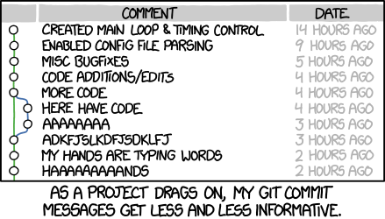
Other Git stuff
Git is complicated; be careful
Run into a problem, look it up
StackOverflow
Github
http://git-scm.com/docs/
man pages
Some online tutorials:
http://pcottle.github.io/learnGitBranching/
https://try.github.io/

Slide 35
Debugging
GDB, Valgrind

Slide 36
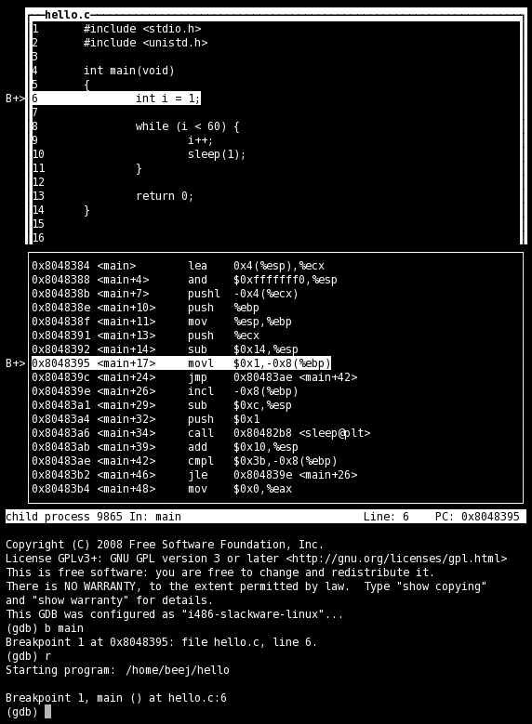
GDB
No longer stepping through assembly!
Use the step/next commands
break on line numbers, functions
Use list to display code at line-numbers and functions
Use print with variables
Use gdbtui
Nice display for viewing source/executing commands

Slide 37
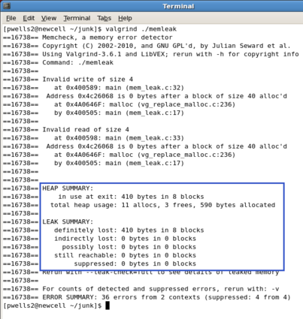
Valgrind
Find memory errors, detect memory leaks
Common errors:
Illegal read/write errors
Use of uninitialized values
Illegal frees
Overlapping source/destination addresses
Typical solutions
Did you allocate enough memory?
Did you accidentally free stack variables/something twice?
Did you initialize all your variables?
Did use something that you just free’d?
--leak-check=full
Memcheck gives details for each definitely/possibly lost memory block (where it was allocated

Slide 38
Compilation
GCC, Make Files

Slide 39
GCC
Used to compile C/C++ projects
List the files that will be compiled to form an executable
Specify options via flags
Important Flags:
-g: produce debug information (important; used by GDB/valgrind)
-Werror: treat all warnings as errors (this is our default)
-Wall/-Wextra: enable all construction warnings
-pedantic: indicate all mandatory diagnostics listed in C-standard
-O1/-O2: optimization levels
-o <filename>: name output binary file ‘filename’
Example:
gcc -g -Werror -Wall -Wextra -pedantic foo.c bar.c -o baz

Slide 40
Make Files
Command-line compilation becomes inefficient when compiling many files together
Solution: use make-files
Single operation to compile files together
Only recompiles updated files
# Makefile for the malloc lab driver
#
CC = gcc
CFLAGS = -Wall -Wextra -Werror -O2 -g -DDRIVER -std=gnu99
OBJS = mdriver.o mm.o memlib.o fsecs.o fcyc.o clock.o ftimer.o
all: mdriver
mdriver: $(OBJS)
$(CC) $(CFLAGS) -o mdriver $(OBJS)
mdriver.o: mdriver.c fsecs.h fcyc.h clock.h memlib.h config.h mm.h
memlib.o: memlib.c memlib.h
mm.o: mm.c mm.h memlib.h
fsecs.o: fsecs.c fsecs.h config.h
fcyc.o: fcyc.c fcyc.h
ftimer.o: ftimer.c ftimer.h config.h
clock.o: clock.c clock.h
clean:
rm -f *~ *.o mdriver

Slide 41
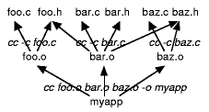
Make File Rules
Comments start with a ‘#’, Commands start with a TAB.
Common Make File Format:
target: source(s) TAB: command TAB: command
Macros: similar to C-macros, find and replace:
CC = gcc CCOPT = -g -DDEBUG -DPRINT foo.o: foo.c foo.h $(CC) $(CCOPT) -c foo.c
See http://www.andrew.cmu.edu/course/15-123-kesden/index/lecture_index.html for more details

Slide 42
Demo Time!
Putting it all together

Slide 43
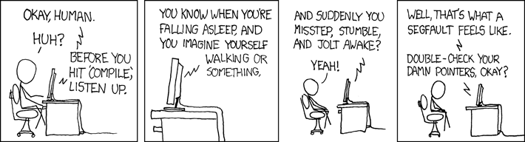
Questions?

